Slide 1
Programming Language I CSE115
Dr. Mohammad Abu Yousuf

Slide 2
The Evolution of Electronic Computing
Communication
becoming
Free !!
Storage
became
Free !!
Computation
became
Free !!
1980
1990
2000
2010

Slide 3
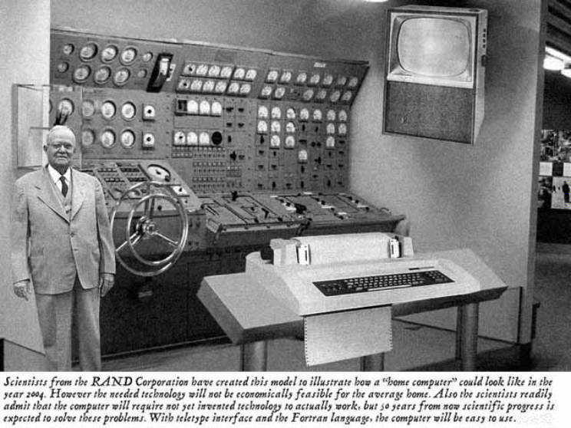
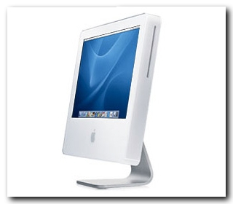
Home Computer @ 2015: Predicted versus Real
Predicted in 1954
Reality

Slide 4

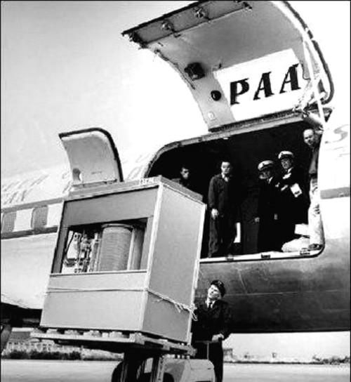
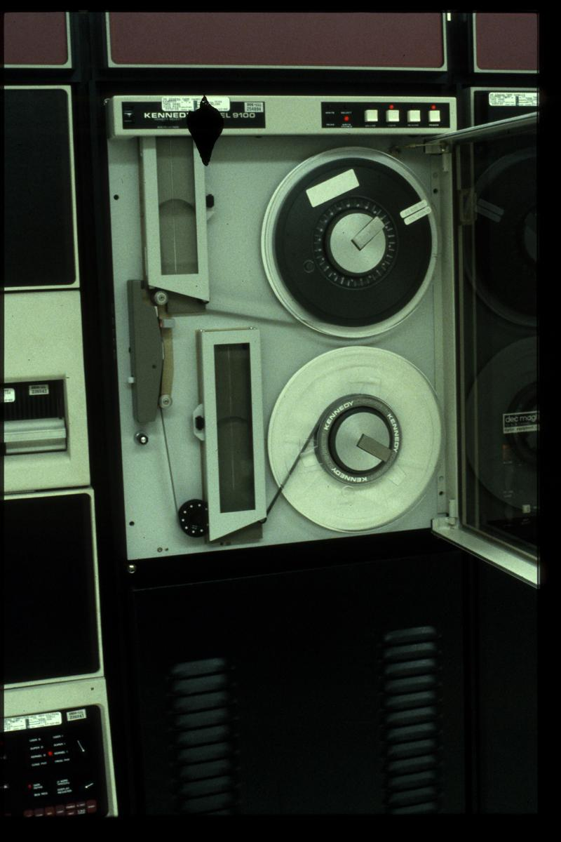
Storage has become free!!
Magnetic Tape Drive
8 GB Pen Drive
5 MB Hard Disk [1956]

Slide 5
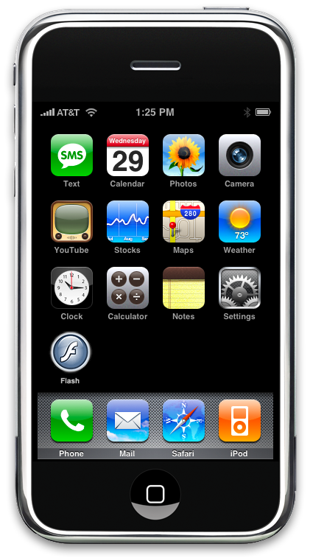
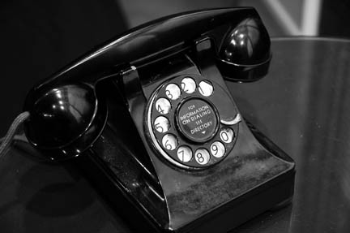
Communication??

Slide 6
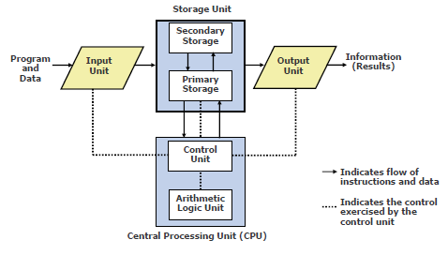
Basic organization of a computer system

Slide 7
Arithmetic Logic Unit & Control Unit
Arithmetic Logic Unit of a computer system is the place where the actual executions of instructions takes place during processing operation
Control Unit of a computer system manages and coordinates the operations of all other components of the computer system

Slide 8

Central Processing Unit (CPU)
It is the brain of a computer system.
It is responsible for controlling the operations of all other units of a computer system

Slide 9
CPU (Cont…)
All computations take place here in order for the computer to perform a designated task.
It has a large number of registers which temporarily store data and programs (instructions).
It has functional units to carry out arithmetic and logic operations
It retrieves instructions from the memory, interprets (decodes) them, and performs the requested operation
Fetch → Decode → Execute cycle
CPU is also referred to as the processor

Slide 10
Number System – The Basics
We are accustomed to using the so-called decimal number system.
Ten digits :: 0,1,2,3,4,5,6,7,8,9
Every digit position has a weight which is a power of 10.
Examples:
234 = 2 x 10² + 3 x 10¹ + 4 x 10⁰
250.67 = 2 x 10² + 5 x 10¹ + 0 x 10⁰ + 6 x 10⁻¹ + 7 x 10⁻²

Slide 11
A computer works on the binary number system
Binary number system:
Two digits :: 0,1
Every digit position has a weight which is a power of 2.
Examples:
101 (Binary) = 1 x 2² + 0 x 2¹ + 1 x 2⁰ = 5 (Decimal)
11001 (Binary)
= 1 x 2⁴ + 1 x 2³ + 0 x 2² + 0 x 2¹ + 1 x 2⁰
= 25 (Decimal)

Slide 12
Bits and Bytes
Bit
A single binary digit (0 or 1).
Byte
A collection of eight bits (say, 01000111).
Word
Depends on the computer.
Typically 4 or 8 bytes (that is, 32 or 64 bits).

Slide 13
Classification of Software
Two categories:
Application Software
Used to solve a particular problem.
Editor, financial accounting, weather forecasting, etc.
System Software
Helps in running other programs.
Compiler, operating system, etc.

Slide 14
Operating Systems
Makes the computer easy to use.
Basically the computer is very difficult to use.
Understands only machine language.
Operating systems make computers easy to use.
Categories of operating systems:
Single user
Multi user
Time sharing
Multitasking
Real time

Slide 15
C Language Overview
The C programming language is a general-purpose, high-level language.
Originally developed by Dennis M. Ritchie at Bell Labs.
C was originally first implemented on the DEC PDP-11 computer in 1972.
In 1978, Brian Kernighan and Dennis Ritchie produced the first publicly available description of C, now known as the K&R standard.

Slide 16
C Language Overview (Cont..)
C was invented to write an operating system called UNIX.
C is a successor of B language, which was introduced around 1970.
In 1983 the American National Standards Institute (ANSI) formed a committee to establish a standard definition.
--Called ANSI Standard C.
The UNIX OS was totally written in C by 1973.

Slide 17
Why use C?
The C has now become a widely used professional language for various reasons.
Easy to learn
Structured language
It produces efficient programs.
It can be compiled on a variety of computer platforms.
In structured programming paradigm, we write functions (sometimes called: procedures, sub routines, methods) to perform certain tasks within the program.

Slide 18
Some Terminologies
Algorithm / Flowchart
A step-by-step procedure for solving a particular problem.
Independent of the programming language.
Program
A translation of the algorithm/flowchart into a form that can be processed by a computer.
Typically written in a high-level language like C, C++, Java, etc.

Slide 19
What is a program?
A sequence of instructions that a computer can interpret and execute.
-If I tell you the way from Bashundhara to Dhanmondi … I will tell sequence of instructions…. Any wrong instruction leads to a undesired result.

Slide 20
Programming Language
Three types of programming languages
Machine languages
Expressed in binary.
Directly understood by the computer.
Not portable; varies from one machine type to another.
-Program written for one type of machine will not run on another type of machine.
Difficult to use in writing programs.
2. Assembly languages
English-like abbreviations representing elementary computer operations (translated via assemblers)
Example:
LOAD BASEPAY
ADD OVERPAY
STORE GROSSPAY

Slide 21
Programming Language (Cont..)
High-level languages
Codes similar to everyday English
Use mathematical notations (translated via compilers)
Example:
grossPay = basePay + overTimePay
High-level languages are easier to use.
-They are closer to the programmer.
-Examples:
Fortran, Cobol, C, C++, Java.
-Requires an elaborate process of translation.
Using a software called compiler.
-They are portable across platforms.

Slide 22
Programming Language (Cont..)
Low-level language:
A machine language or an assembly language. Low-level languages are closer to the hardware than are high-level programming languages, which are closer to human languages.

Slide 23
From HLL to executable
HLL
Program
Compiler
Linker
Object
Code
Executable
Code
Libraries

Slide 24
Some programmer jargon
Some words that will be used a lot:
Source code: The stuff you type into the computer. The program you are writing.
Compile (build): Taking source code and making a program that the computer can understand.
Executable: The compiled program that the computer can run.
Language: The core part of C central to writing C code.
Library: Added functions for C programming which are bolted on to do certain tasks.
Header file: Files ending in .h which are included at the start of source code.

Slide 25
Compilation
Compilation translates your source code (in the file hello.c) into object code (machine dependent instructions for the particular machine you are on).
Linking the object code will generate an executable file.

Slide 26
Problem solving
Step 1:
Clearly specify the problem to be solved.
Step 2:
Draw flowchart or write algorithm.
Step 3:
Convert flowchart (algorithm) into program code.
Step 4:
Compile the program into object code.
Step 5:
Execute the program.

Slide 27
Flowchart: basic symbols
Computation
Input / Output
Decision Box
Start / Stop
Flow of control

Slide 28
Example 1: Adding three numbers
START
READ A, B, C
S = A + B + C
OUTPUT S
STOP

Slide 29
Example 2: Larger of two numbers
START
READ X, Y
YES
IS
X>Y?
NO
OUTPUT X
OUTPUT Y
STOP
STOP

Slide 30
Example 3: Largest of three numbers
START
READ X, Y, Z
YES
IS
X > Y?
NO
Max = X
Max = Y
YES
IS
Max > Z?
NO
OUTPUT Max
OUTPUT Z
STOP
STOP

Slide 31
Example 3: Largest of three numbers
#include <stdio.h>
/* FIND THE LARGEST OF THREE NUMBERS */
main()
{
int a, b, c, max;
scanf (“%d %d %d”, &x, &y, &z);
if (x>y)
max = x;
else max = y;
if (max > z)
printf(“Largest is %d”, max);
else printf(“Largest is %d”, z);
}
START
READ X, Y, Z
YES
IS
X > Y?
NO
Max = X
Max = Y
YES
IS
Max > Z?
NO
OUTPUT Max
OUTPUT Z
STOP
STOP

Slide 32
Our First C Program: Hello World
#include <stdio.h>
main ( )
{
printf ("Hello, World!\n");
}

Slide 33
Our First C Program: Hello World
Preprocessor
#include <stdio.h>
/* This program prints “Hello World” */
main()
{
printf(“Hello World!\n”);
}
Comments are good
main( ) means “start here”
Library command
Brackets define code blocks

Slide 34
Our First C Program: Hello World (Cont..)
Comments
Text surrounded by /* and */ is ignored by computer Used to describe program
#include <stdio.h>
Preprocessor directive
Tells computer to load contents of a certain file
<stdio.h> allows standard input/output operations
int main()
C++ programs contain one or more functions, exactly one of which must be main
Parenthesis used to indicate a function
int means that main "returns" an integer value
Braces ({ and }) indicate a block
The bodies of all functions must be contained in braces

Slide 35
Our First C Program: Hello World (Cont..)
printf( "Welcome to C!\n" );
Instructs computer to perform an action
Specifically, prints the string of characters within quotes (“ ”)
Entire line called a statement
All statements must end with a semicolon (;)
Escape character (\)
Indicates that printf should do something out of the ordinary
\n is the newline character

Slide 36
Our First C Program: Hello World (Cont..)
return 0;
A way to exit a function
return 0, in this case, means that the program terminated normally
Right brace }
Indicates end of main has been reached
Linker
When a function is called, linker locates it in the library
Inserts it into object program
If function name is misspelled, the linker will produce an error because it will not be able to find function in the library

Slide 37
Example 1: Adding two numbers
START
#include <stdio.h>
main()
{
int a, b, c;
scanf(“%d%d”,&a, &b);
c = a + b;
printf(“%d”,c);
}
Variable Declaration
READ A, B
C = A + B
PRINT C
STOP

Slide 38
Example 2 : Area of a circle
#include <stdio.h>
int main ()
{ int radius;
float area;
printf ("Enter radius (i.e. 10) : ");
scanf ( "%d", &radius);
area = 3.14159 * radius * radius;
printf ("\nArea = %f\n\n", area);
return 0;
}

Slide 39
Example 3
#include <stdio.h>
int main ()
{
int i, j;
for (i = 0; i < 10; i++)
{
printf ("\n");
for (j = 0; j < i+1; j++ )
printf ( "A");
}
printf("\n");
return 0;
}

Slide 40
Structure of a C program
Every C program consists of one or more functions.
One of the functions must be called main.
The program will always begin by executing the main function.
Each function must contain:
A function heading, which consists of the function name, followed by an optional list of arguments enclosed in parentheses.
A list of argument declarations.
A compound statement, which comprises the remainder of the function.

Slide 41
Desirable Programming Style
Clarity
The program should be clearly written.
It should be easy to follow the program logic.
Meaningful variable names
Make variable/constant names meaningful to enhance program clarity.
‘area’ instead of ‘a’
‘radius’ instead of ‘r’
Program documentation
Insert comments in the program to make it easy to understand.
Never use too many comments.
Program indentation
-- Use proper indentation.
Structure of the program should be immediately visible.

Slide 42
Indentation Example: Good Style
#include <stdio.h>
/* FIND THE LARGEST OF THREE NUMBERS */
main()
{
int a, b, c;
scanf(“%d%d%d”, &a, &b, &c);
if ((a>b) && (a>c))
printf(“\n Largest is %d”, a);
else
if (b>c)
printf(“\n Largest is %d”, b);
else
printf(“\n Largest is %d”, c);
}

Slide 43
Indentation Example: Bad Style
#include <stdio.h>
/* FIND THE LARGEST OF THREE NUMBERS */
main()
{
int a, b, c;
scanf(“%d%d%d”, &a, &b, &c);
if ((a>b) && (a>c))
printf(“\n Largest is %d”, a);
else
if (b>c)
printf(“\n Largest is %d”, b);
else
printf(“\n Largest is %d”, c);
}

Slide 44
Keywords of C
Flow control (6) – if, else, return, switch, case, default
Loops (5) – for, do, while, break, continue
Common types (5) – int, float, double, char, void
Structures (3) – struct, typedef, union
Counting and sizing things (2) – enum, sizeof

Slide 45
Keywords of C (Cont..)
Rare but still useful types (7) – extern, signed, unsigned, long, short, static, const
Evil keywords which we avoid (1) – goto
(3) – auto, register, volatile

Slide 46
The C Character Set
The C language alphabet:
Uppercase letters ‘A’ to ‘Z’
Lowercase letters ‘a’ to ‘z’
Digits ‘0’ to ‘9’
Certain special characters:
! # % ^ & * ( )
_ + = ~ [ ] \
| ; : ‘ “ { } ,
. < > / ? blank

Slide 47
Some simple operations for variables
In addition to +, -, * and / we can also use
+=, -=, *=, /=, -- and % (modulo)
n++ increment n
n-- decrement n
a+=5 is equivalent to a = a+5;
a-=5 is equivalent to a = a-5;
a*=5 is equivalent to a = a*5;
a/=5 is equivalent to a = a/5;
(x % y) gives the remainder when x is divided by y

Slide 48
Identifiers and Keywords
Identifiers
Names given to various program elements (variables, constants, functions, etc.)
May consist of letters, digits and the underscore (‘_’) character, with no space between.
First character must be a letter or underscore.
An identifier can be arbitrary long.
Some C compilers recognize only the first few characters of the name (16 or 31).
Case sensitive
‘area’, ‘AREA’ and ‘Area’ are all different.

Slide 49
Valid and Invalid Identifiers
Valid identifiers
X
abc
simple_interest
a123
LIST
stud_name
Empl_1
Empl_2
avg_empl_salary
Invalid identifiers
10abc
my-name
“hello”
simple interest
(area)
%rate

Slide 50
C Variables Names (1)
Variable Names:
Names may contain letters, digits and underscores
The first character must be a letter or an underscore.
the underscore can be used but watch out!!
Case matters!
C keywords cannot be be used as variable names.
present, hello, y2x3, r2d3, ... /* OK */
_1993_tar_return /* OK but don’t */
Hello#there /* illegal */
double /* shouldn’t work */
2fartogo /* illegal */

Slide 51
C Variables Names (2)
Suggestions regarding variable names:
DO: use variable names that are descriptive
DO: adopt and stick to a standard naming convention
sometimes it is useful to do this consistently for the entire software development site
AVOID: variable names starting with an underscore
often used by the operating system and easy to miss
AVOID: using uppercase only variable names
generally these are pre-processor macros (later)

Slide 52
Data Types in C (1)
int :: integer quantity
Typically occupies 4 bytes (32 bits) in memory.
char :: single character
Typically occupies 1 byet (8 bits) in memory.
float :: floating-point number (a number with a decimal point)
Typically occupies 4 bytes (32 bits) in memory.
double :: double-precision floating-point number

Slide 53
Data Types in C (2)
There are a number of qualifiers which can be applied to the basic types
length of data
short int: v "shorter" int, <= number of bits in an int
v can also just write "short"
long int: v a "longer int", >= number of bits in an int
v often the same number of bits as an int
v can also just write "long"
long double v generally extended precision floating point

Slide 54
Data Types in C (3)
signed and unsigned
unsigned int v an int type with no sign
v if int has 32-bits, range from 0..2³²-1
v also works with long and short
unsigned charv a number from 0 to 255
signed char va number from –128 to 127 (8-bit signed value) v very similar to byte in Java

Slide 55
Some Examples of Data Types
int
0, 25, -156, 12345, −99820
char
‘a’, ‘A’, ‘*’, ‘/’, ‘ ’
float
23.54, −0.00345, 25.0

